Slide 1
FLASK

Slide 2
Introduction-Flask
It is Web application framework written in python
Web Framework-Application framework that represents collection of libraries/modules without bothering about low level details like protocol
It is based on Werkzeug WSGI Toolkit and Jinga2 Template Engine-Web templating engine
Werkzeug-WSGI Toolkit which handles request and response objects and utility functions
Jinga2 –Popular templating engine for python; A web templating engine combines template with a data source to render some dynamic web pages

Slide 3
Why Flask?
Flask is used for developing web applications using python, implemented on Werkzeug and Jinja2. Advantages of using Flask framework are:
There is a built-in development server and a fast debugger provided.
Lightweight
Secure cookies are supported.
Templating using Jinja2.
Request dispatching using REST.
Support for unit testing is built-in.

Slide 4
Video Tutorial
A brilliant introduction to Flask
https://www.youtube.com/watch?v=F7AK-WzpYdY
Flask Tutorial #1 - How to Make Websites with Python
https://www.youtube.com/watch?v=mqhxxeeTbu0
Learn Flask for Python - Full Tutorial
https://www.youtube.com/watch?v=Z1RJmh_OqeA

Slide 5
Virtualenv is a tool for isolating your application in what is called a virtual environment.
A Virtual Environment is a directory that contains the software on which your application depends.
Use a virtual environment to manage the dependencies for your project, both in development and in production.
What problem does a virtual environment solve? The more Python projects you have, the more likely it is that you need to work with different versions of Python libraries, or even Python itself. Newer versions of libraries for one project can break compatibility in another project.
Virtual environments are independent groups of Python libraries, one for each project. Packages installed for one project will not affect other projects or the operating system’s packages.
Python comes bundled with the venv module to create virtual environments.

Slide 6
Installing Flask
Virtualenv is the Virtual Python Environment Builder
To install Virtualenv type in the command Pip install virtualenv
Create an environment:
Mac | Windows
Create an environment¶ Create a project folder and a .venv folder within:
$ mkdir myproject $ cd myproject $ python3 -m venv .venv | > mkdir myproject > cd myproject > py -3 -m venv .venv
Activate the environment Before you work on your project, activate the corresponding environment:
$ . .venv/bin/activate | > .venv\Scripts\activate
Your shell prompt will change to show the name of the activated environment.
Install Flask¶ Within the activated environment, use the following command to install Flask:
$ pip install Flask
Notes:
Create an environment
Create a project folder and a .venv folder within:
mkdir myproject
cd myproject
py -3 -m venv .venv
Activate the environment¶
Before you work on your project, activate the corresponding environment:
.venv\Scripts\activate

Slide 7
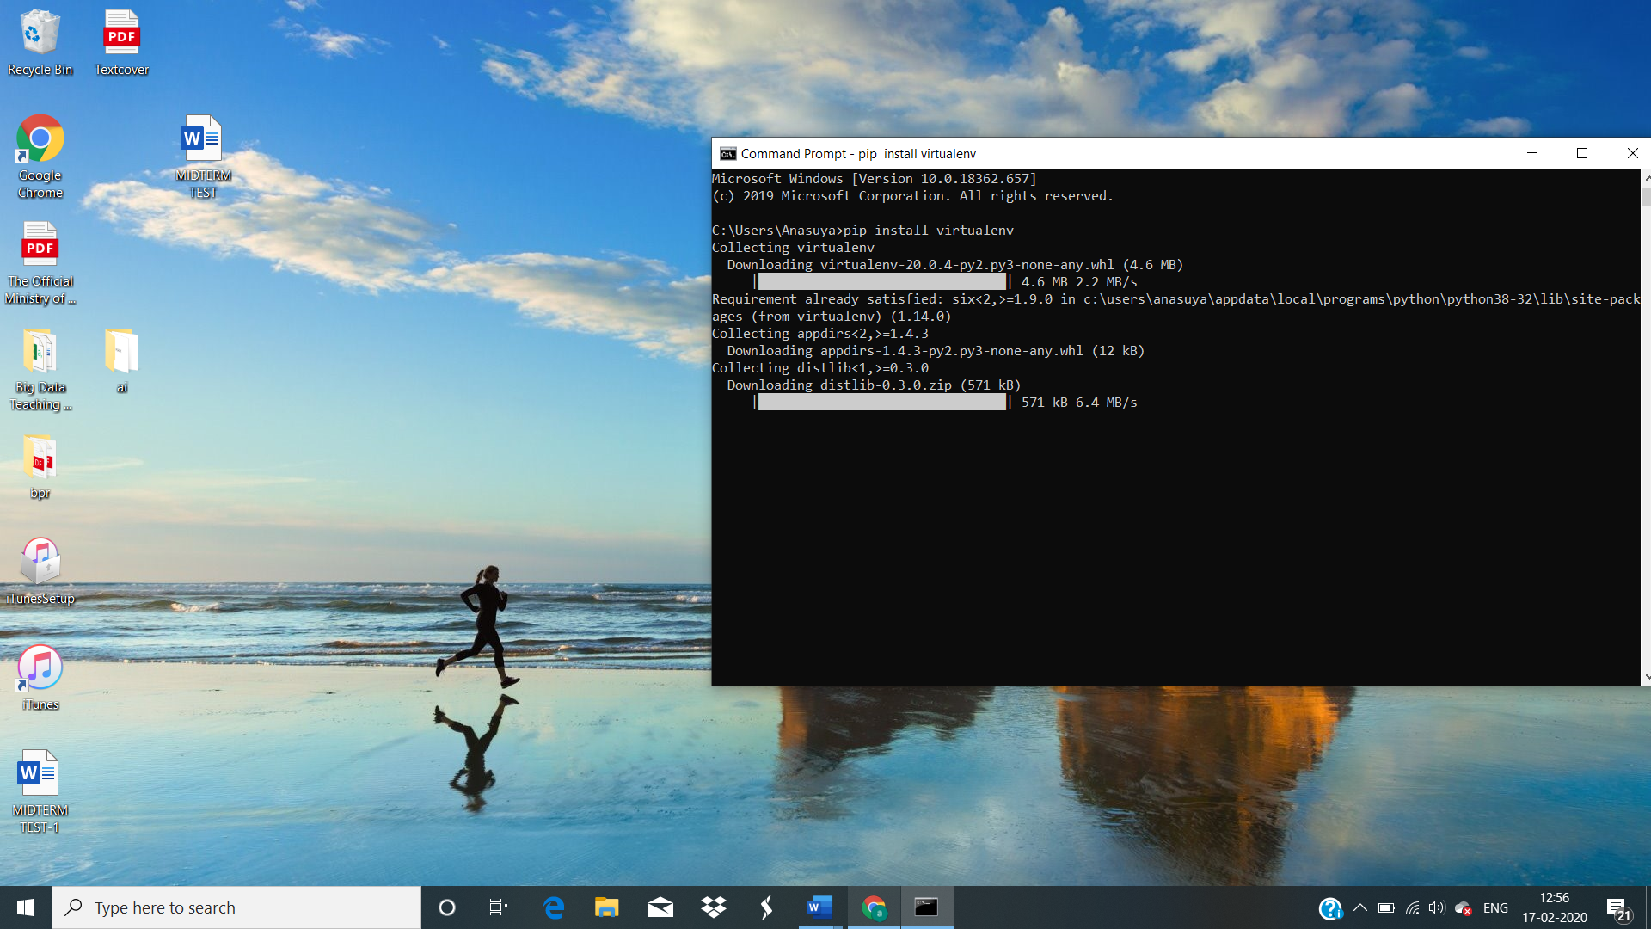
Virtualenv

Slide 8
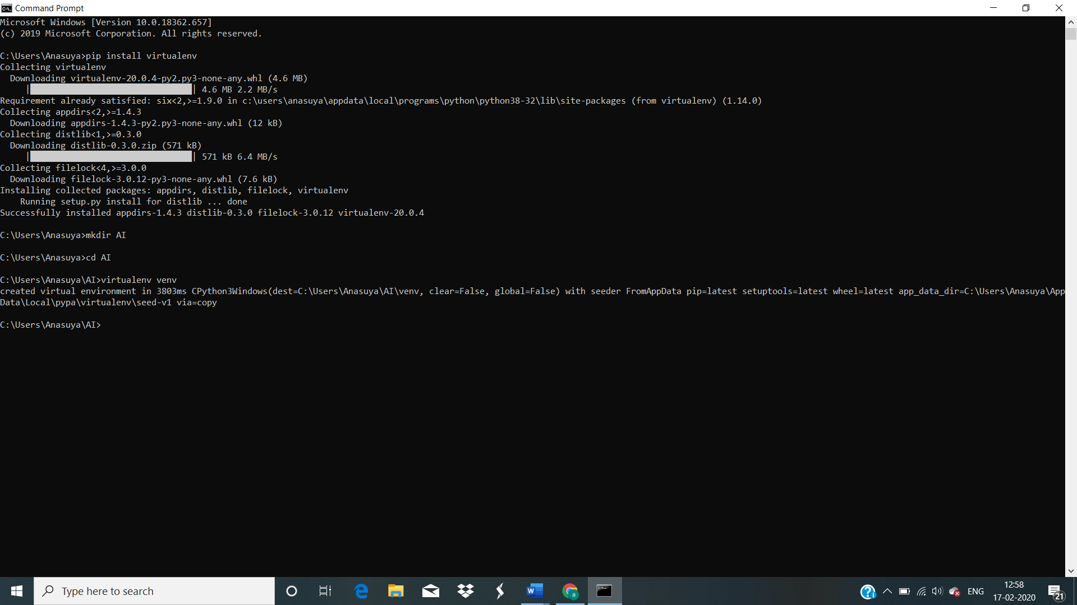

Slide 9
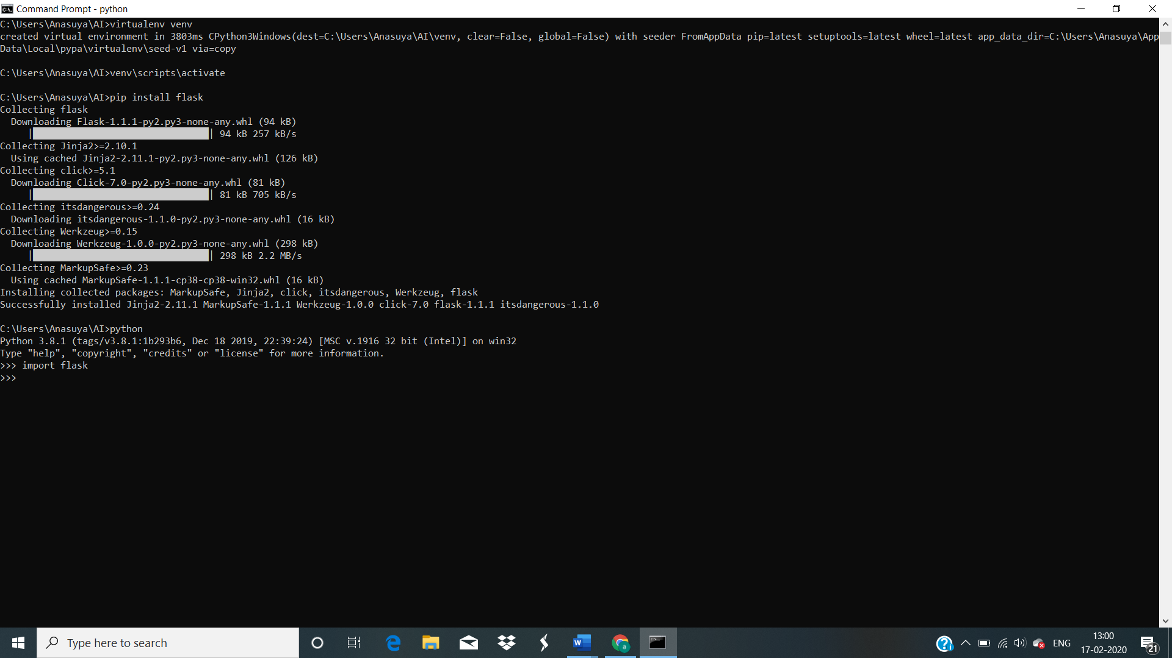

Slide 10
First Program
In order to test Flask installation, type the following code in the editor as Hello.py
Testing the flask installing
Simple program: app.py
from flask import Flask # we imported the Flask class. An instance of this class will be our WSGI application app = Flask(__name__) #creating the Flask class object @app.route('/') #We then use the route() decorator to tell Flask what URL should trigger our function. def hello_world(): #function return "<p>Hello, World!</p>" if __name__ == "__main__": # It Allows You to Execute Code When the File Runs as a Script, app.run()

Slide 11
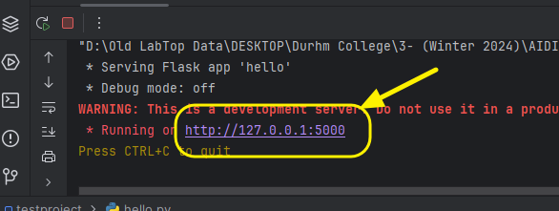
The above given Python script is executed from Python shell.
Python Hello.py
A message in Python shell informs you that
* Running on http://127.0.0.1:5000/ (Press CTRL+C to quit)
Open the above URL (localhost:5000) in the browser. ‘Hello World’ message will be displayed on it.
OR You can run the program from your Jupyter Notebook.

Slide 12
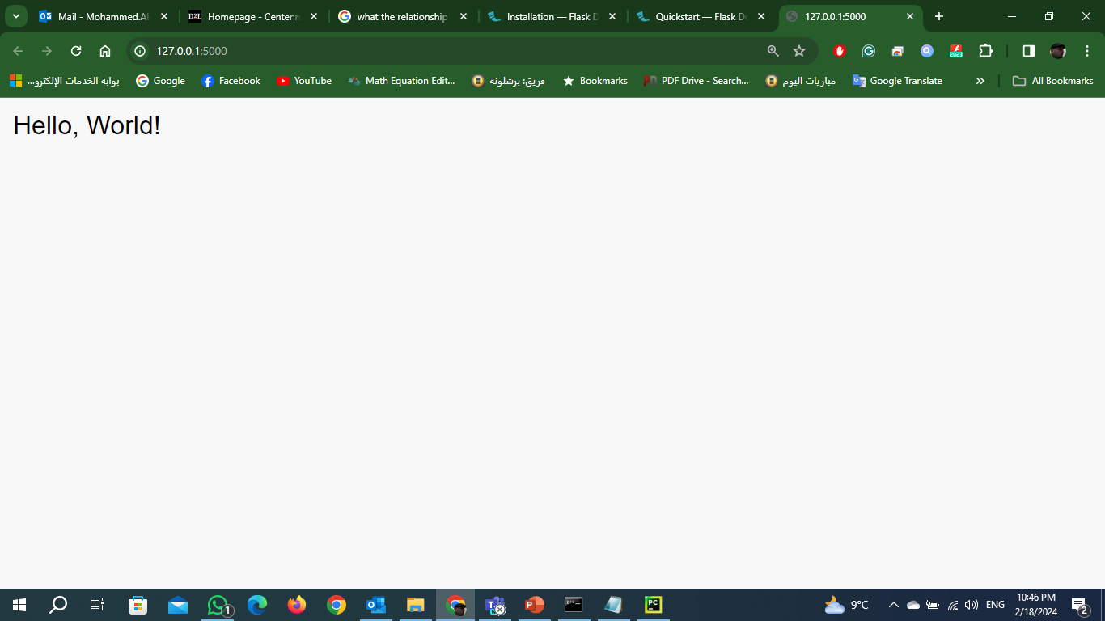

Slide 13
Route() / Generating dynamic URLs in Flask
The route() decorator in Flask is used to bind URL to a function.
@app.route(‘/hello’)
def hello_world():
return ‘hello world’
A decorator’s purpose is also served by the following representation −
def hello_world():
return ‘hello world’
app.add_url_rule(‘/’, ‘hello’, hello_world)
from flask import Flask app = Flask(__name__) @app.route('/hello') def home(): return "hello, this is our first flask website" app.add_url_rule('/','hello',home) if __name__ == "__main__": app.run()
Notes:
Modern web frameworks use the routing technique to help a user remember application URLs.
It is useful to access the desired page directly without having to navigate from the home page.
URL ‘/hello’ rule is bound to the hello_world() function.
As a result, if a user visits http://localhost:5000/hello URL, the output of the hello_world() function will be rendered in the browser.
The add_url_rule() function of an application object is also available to bind a URL with a function as in the above example, route() is used.

Slide 14
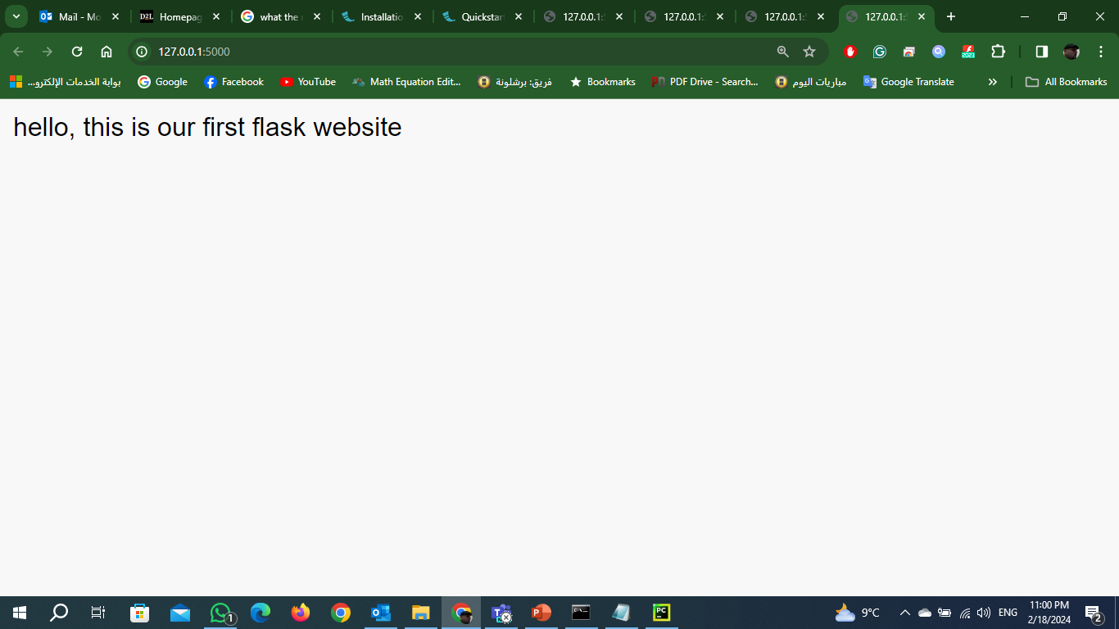
Route() / Generating dynamic URLs in Flask
Notes:
Modern web frameworks use the routing technique to help a user remember application URLs.
It is useful to access the desired page directly without having to navigate from the home page.
URL ‘/hello’ rule is bound to the hello_world() function.
As a result, if a user visits http://localhost:5000/hello URL, the output of the hello_world() function will be rendered in the browser.
The add_url_rule() function of an application object is also available to bind a URL with a function as in the above example, route() is used.

Slide 15
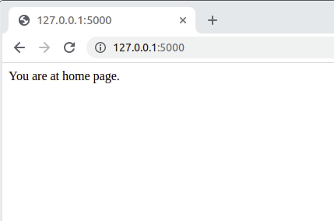
#importing the flask Module from flask import Flask # Flask constructor takes the name of # current module (__name__) as argument app = Flask(__name__) @app.route('/') # ‘/’ URL is bound with hello_world() function. def home(): return 'You are at home page.' @app.route('/allow') def allow(): return 'You have been allowed to enter.' @app.route('/disallow') def disallow(): return 'You have not been allowed to enter.' # main driver function if __name__ == '__main__': # run() method of Flask class runs the application # on the local development server. app.run()
Notes:
https://www.geeksforgeeks.org/generating-dynamic-urls-in-flask/

Slide 16
Build the URL Dynamically
To build a URL dynamically, by adding variable parts to the rule parameter. This variable part is marked as <variable-name>.
from flask import Flask
app = Flask(__name__)
@app.route('/home/<name>')
def home(name):
return "hello,"+name;
if __name__ =="__main__":
app.run( )
Notes:
It is passed as a keyword argument to the function with which the rule is associated.
In the following example, the rule parameter of route() decorator contains <name> variable part attached to URL ‘/hello’.
Hence, if the http://localhost:5000/hello/AI is entered as a URL in the browser, ‘AI’ will be supplied to hello() function as argument.

Slide 17
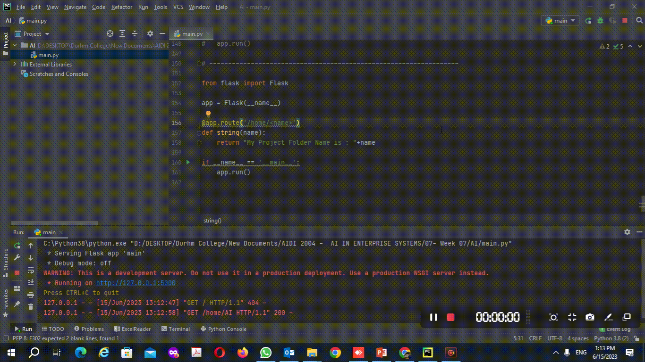
from flask import Flask app = Flask(__name__) @app.route('/home/<name>') def string(name): return "My Project Folder Name is : "+name if __name__ == '__main__': app.run()

Slide 18
Other Convertors
The following converters are used to convert the default string type to the associated data type.
String: default
Int: used to convert the string to the integer
Float: used to convert the string to the float.
Path: It can accept the slashes given in the URL.

Slide 19
from flask import Flask app = Flask(__name__) @app.route('/home/<string:name>') def string(name): return "My Project Folder Name is : %s" %name if __name__ == '__main__': app.run()

Slide 20
Example for Convertor
The converter can also be used in the URL to map the specified variable to the particular data type. For example, we can provide the integers or float like age or salary respectively.
Consider the following example.
from flask import Flask
app = Flask(__name__)
@app.route('/home/<int:age>')
def home(age):
return "Age = %d"%age;
if __name__ =="__main__":
app.run( )

Slide 21
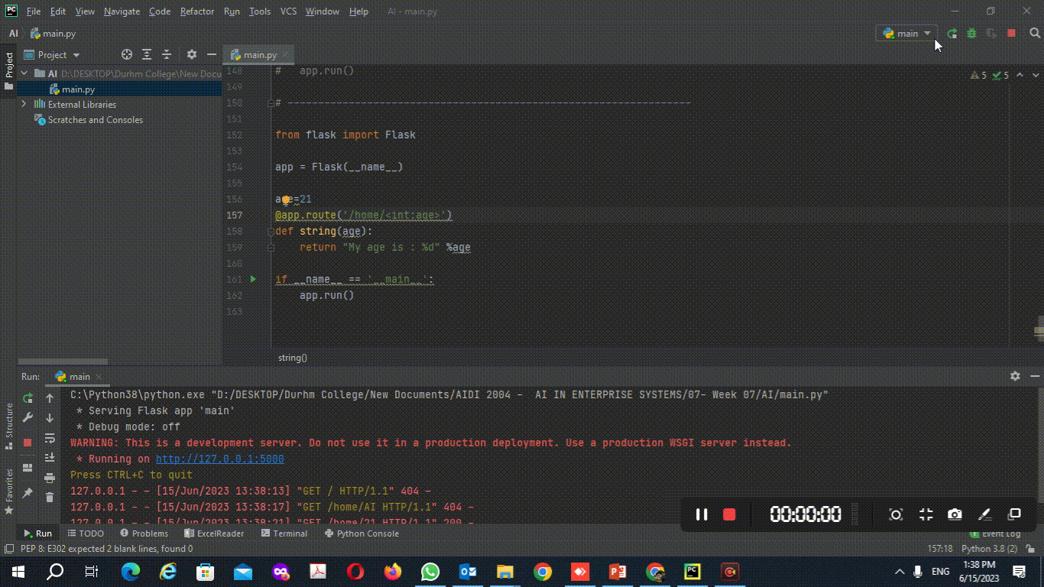
from flask import Flask app = Flask(__name__) age=21 @app.route('/home/<int:age>') def string(age): return "My age is : %d" %age if __name__ == '__main__': app.run()

Slide 22
Other Representation of URL Binding
There is one more approach to perform routing for the flask web application that can be done by using the add_url_rule() function of the Flask class.
The syntax to use this function is given below.
add_url_rule(<url rule>, <endpoint>, <view function>)

Slide 23
Example
from flask import Flask
app = Flask(__name__)
def about():
return "This is about page";
app.add_url_rule("/about","about",about)
if __name__ =="__main__":
app.run(debug = True)

Slide 24
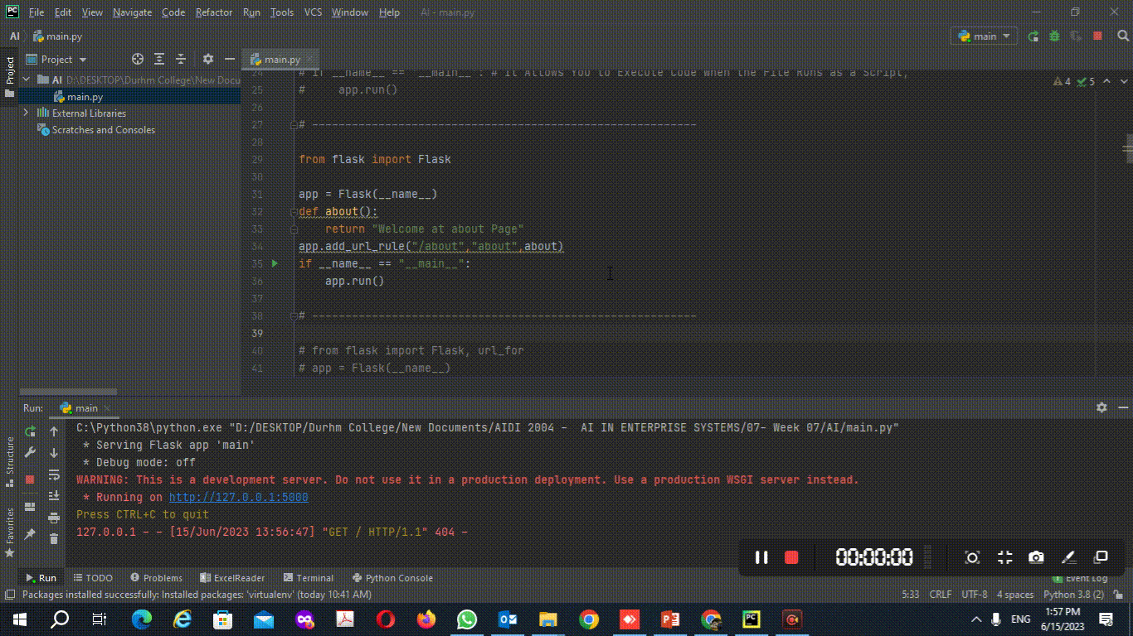
from flask import Flask app = Flask(__name__) def about(): return "Welcome at about Page" app.add_url_rule("/about","about",about) if __name__ == "__main__": app.run()

Slide 25
URL_FOR()
The url_for() function is used to build a URL to the specific function dynamically.
The first argument is the name of the specified function, and then we can pass any number of keyword argument corresponding to the variable part of the URL.
This function is useful in the sense that we can avoid hard-coding the URLs into the templates by dynamically building them using this function.

Slide 26
from flask import *
app = Flask(__name__)
@app.route('/admin')
def admin():
return 'admin'
@app.route('/librarian')
def librarian():
return 'librarian'
@app.route('/student')
def student():
return 'student'
@app.route('/user/<name>')
def user(name):
if name == 'admin':
return redirect(url_for('admin'))
if name == 'librarian':
return redirect(url_for('librarian'))
if name == 'student':
return redirect(url_for('student'))
if __name__ =='__main__':
app.run( )

Slide 27
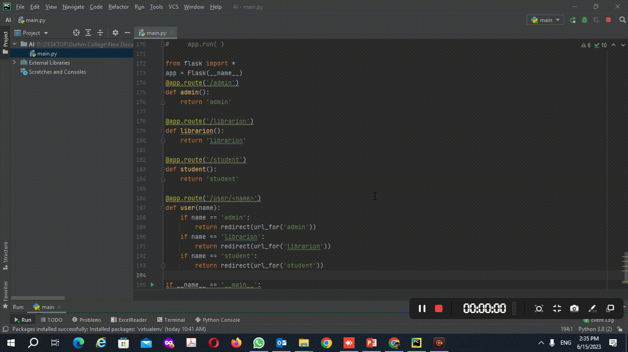
from flask import * app = Flask(__name__) @app.route('/admin') def admin(): return 'admin' @app.route('/librarion') def librarion(): return 'librarion' @app.route('/student') def student(): return 'student' @app.route('/user/<name>') def user(name): if name == 'admin': return redirect(url_for('admin')) if name == 'librarion': return redirect(url_for('librarion')) if name == 'student': return redirect(url_for('student')) if __name__ == '__main__': app.run()

Slide 28
HTTP Methods
Sr.No. | Methods & Description
1 | GET Sends data in unencrypted form to the server. Most common method.
2 | HEAD Same as GET, but without response body
3 | POST Used to send HTML form data to server. Data received by POST method is not cached by server.
4 | PUT Replaces all current representations of the target resource with the uploaded content.
5 | DELETE Removes all current representations of the target resource given by a URL
Notes:
Http protocol is the foundation of data communication in world wide web.
Different methods of data retrieval from specified URL are defined in this protocol.
By default, the Flask route responds to the GET requests. However, this preference can be altered by providing methods argument to route() decorator.

Slide 29
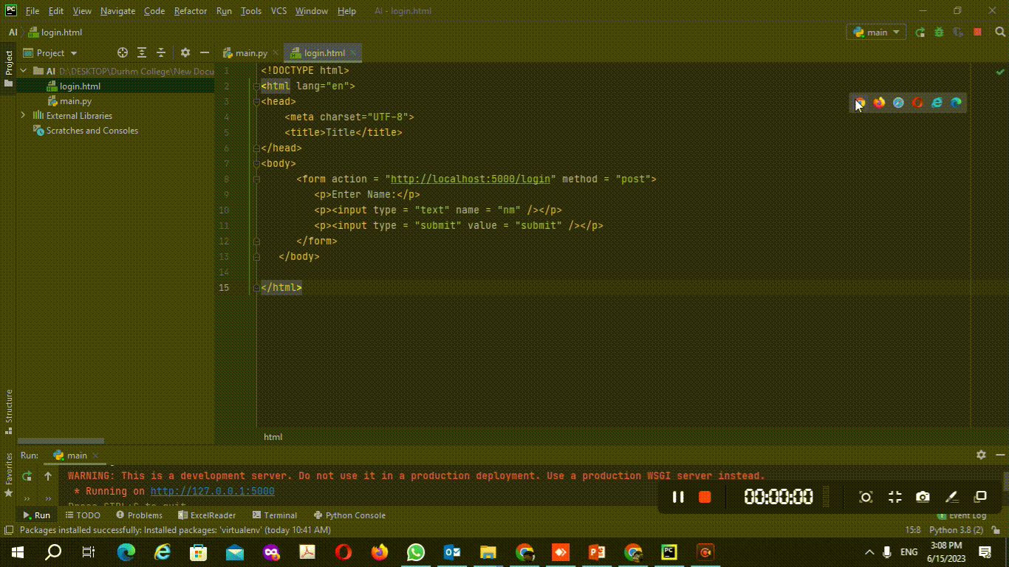
Flask HTTP methods, handle GET & POST requests
from flask import Flask, redirect, url_for, request app = Flask(__name__) @app.route('/success/<name>') def success(name): return 'welcome %s' % name @app.route('/login’, methods = ['POST', 'GET']) def login(): if request.method == 'POST': user = request.form['nm'] return redirect(url_for('success',name = user)) else: user = request.args.get('nm') return redirect(url_for('success',name = user)) if __name__ == '__main__': app.run()
Notes:
https://pythonbasics.org/flask-http-methods/

Slide 30
Creating a HTML File for POST
Save the following script as login.html
<html>
<body>
<form action = "http://localhost:5000/login" method = "post">
<p>Enter Name:</p>
<p><input type = "text" name = "nm" /></p>
<p><input type = "submit" value = "submit" /></p>
</form>
</body>
</html>
Notes:
In order to demonstrate the use of POST method in URL routing, first let us create an HTML form and use the POST method to send form data to a URL.

Slide 31
Flask Templates
We have returned the simple string as the response from the view function. flask facilitates us to return the response in the form of HTML templates; ways using which we can return the HTML response from the web applications.

Slide 32
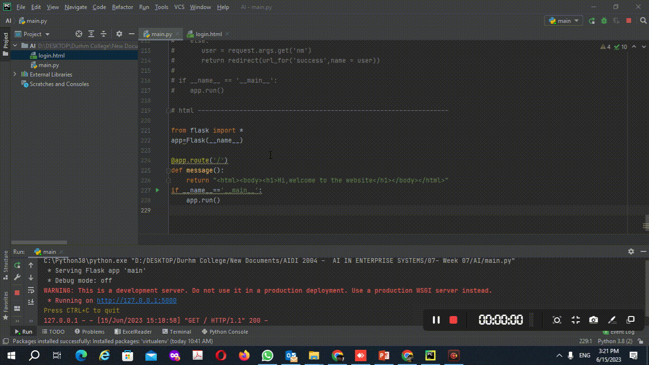
i.e., the message() which is associated with the URL '/’. Instead of returning a simple plain string as a message, it returns a message with <h1> tag attached to it using HTML.
Create Flask Script Contains a View Functions
from flask import * app=Flask(__name__) @app.route('/') def message(): return "<html><body><h1>Hi,welcome to the website</h1></body></html>“
if __name__=='__main__': app.run()

Slide 33
Rendering external HTML files
Flask facilitates us to render the external HTML file instead of hardcoding the HTML in the view function. Here, we can take advantage of the jinja2 template engine on which the flask is based.
Flask provides us the render_template() function which can be used to render the external HTML file to be returned as the response from the view function.
Flask will try to find the HTML file in the templates folder, in the same folder in which this script is present.

Slide 34
Creating the Template Folder
create the folder templates folder inside the application directory and save the HTML templates referenced in the flask script in that directory.
In our case, the path of our script file Prog.py is C:\AI whereas the path of the HTML template is C:\AI\templates.
Application Directory
Prog.py
templates
message.html

Slide 35
Example
To render an HTML file from the view function, create an HTML file named as hello.html.
<html>
<head>
<title>Message</title>
</head>
<body>
<h1>hi, welcome to the website </h1>
</body>
</html>

Slide 36
Rendering external HTML files
from flask import Flask
app = Flask(__name__)
@app.route('/')
def index():
return render_template(‘hello.html’)
if __name__ == '__main__':
app.run(debug = True)
Notes:
one can take advantage of Jinja2 template engine, on which Flask is based. Instead of returning hardcode HTML from the function, a HTML file can be rendered by the render_template() function.

Slide 37
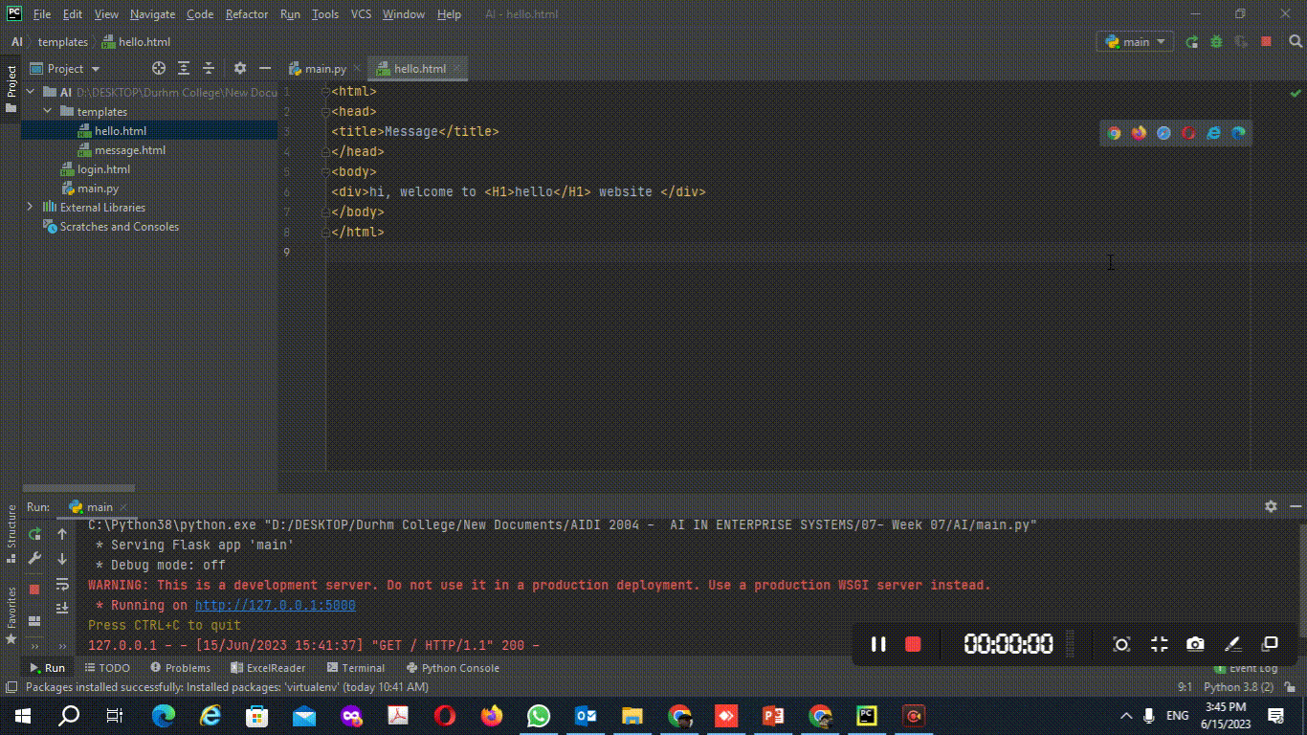
render_template() to render the external HTML file
from flask import Flask, render_template app = Flask(__name__) @app.route('/') def index(): return render_template('hello.html') if __name__ == '__main__': app.run()
<html> <head> <title>Message</title> </head> <body> <div>hi, welcome to <H1>hello</H1> website</div> </body> </html>

Slide 38
Template
Flask will try to find the HTML file in the templates folder, in the same folder in which this script is present.
Application folder
Hello.py
templates
hello.html
Notes:
web templating system’ refers to designing an HTML script in which the variable data can be inserted dynamically.
A web template system comprises of a template engine, some kind of data source and a template processor.
Flask uses jinja2 template engine.
A web template contains HTML syntax interspersed placeholders for variables and expressions (in these case Python expressions) which are replaced values when the template is rendered.

Slide 39
Creating a HTML File
The following code is saved as hello2.html in the templates folder.
<!doctype html>
<html>
<body>
<h1>Hello {{ name }}!</h1>
</body>
</html>

Slide 40
Flask
from flask import Flask, render_template
app = Flask(__name__)
@app.route('/hello/<user>')
def hello_name(user):
return render_template('hello2.html', name = user)
if __name__ == '__main__':
app.run(debug = True)

Slide 41
Output
http://127.0.0.1:5000/user/admin
Output is hi,admin

Slide 42
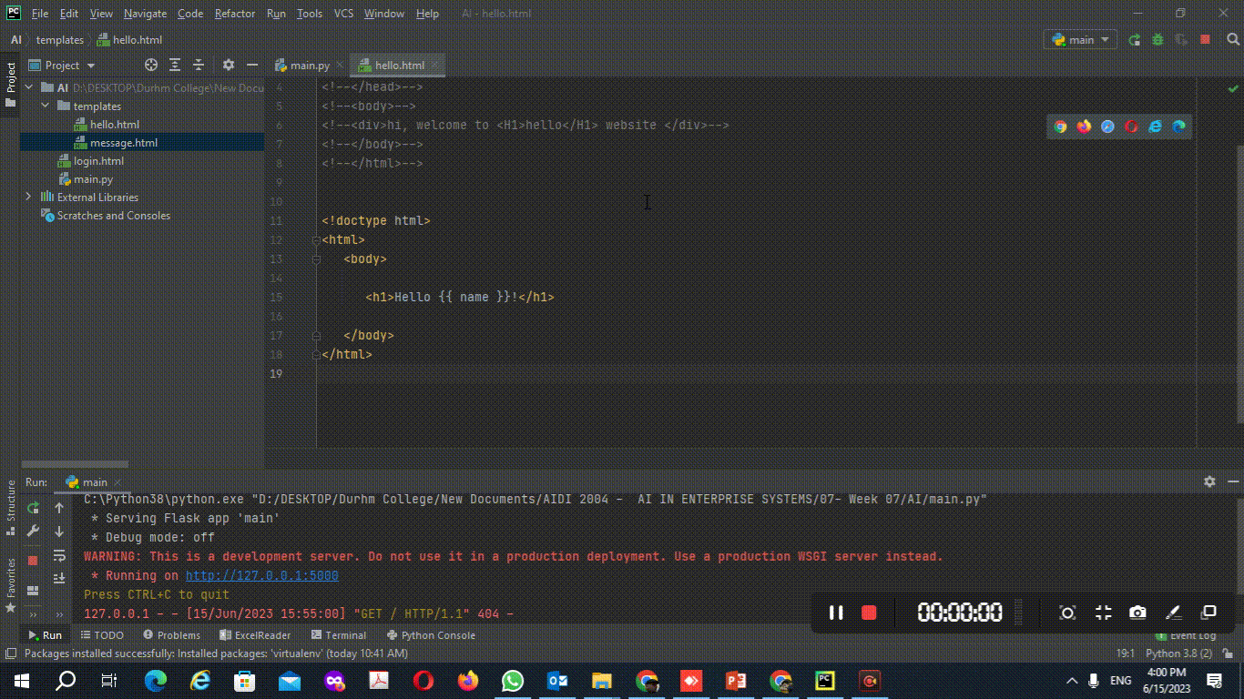
render_template() to render and pass variables to the external HTML file
<!doctype html> <html> <body> <h1>Hello {{ name }}!</h1> </body> </html>
from flask import Flask, render_template app = Flask(__name__) @app.route('/hello/<user>') def hello_name(user): return render_template('hello.html', name = user) if __name__ == '__main__': app.run()

Slide 43
Contd..
The jinja2 template engine uses the following delimiters for escaping from HTML.
{% ... %} for Statements (Control statements)
{{ ... }} for Expressions to print to the template output
{# ... #} for Comments not included in the template output
# ... ## for Line Statements

Slide 44
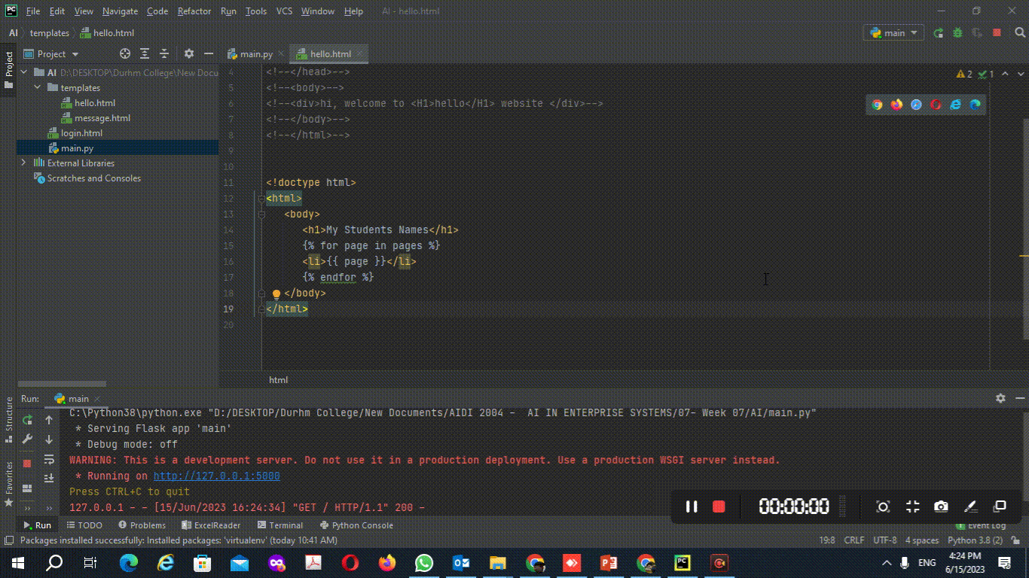
jinja2 template (pass list of names using loop)
<!doctype html> <html> <body> <h1>My Students Names</h1> {% for page in pages %} <li>{{ page }}</li> {% endfor %} </body> </html>
from flask import Flask, render_template app = Flask(__name__) @app.route('/') def hello_name(): names_list = ['Sayd', 'Mohammed', 'Aysegul','Shahabuddin'] return render_template('hello3.html', pages=names_list) if __name__ == '__main__': app.run()
Notes:
https://www.geeksforgeeks.org/python-using-for-loop-in-flask/

Slide 45
Flask Request Object
In the client-server architecture, the request object contains all the data that is sent from the client to the server.
N | Attribute | Description
1 | Form | It is the dictionary object which contains the key-value pair of form parameters and their values.
2 | args | It is parsed from the URL. It is the part of the URL which is specified in the URL after question mark (?).
3 | Cookies | It is the dictionary object containing cookie names and the values. It is saved at the client-side to track the user session.
4 | files | It contains the data related to the uploaded file.
5 | method | It is the current request method (get or post).

Slide 46
Form data retrieval on the template
the / URL renders a web page customer.html that contains a form which is used to take the customer details as the input from the customer.
The data filled in this form is posted to the /success URL which triggers the print_data() function. The print_data() function collects all the data from the request object and renders the result_data.html file which shows all the data on the web page.
The application contains three files, i.e., script.py, customer.html, and result_data.html.
Notes:
In the following example, the / URL renders a web page customer.html that contains a form which is used to take the customer details as the input from the customer.
The data filled in this form is posted to the /success URL which triggers the print_data() function.
The print_data() function collects all the data from the request object and renders the result_data.html file which shows all the data on the web page.

Slide 47
Customer.Html file
<html>
<body>
<h3>Register the customer, fill the following form.</h3>
<form action = "http://localhost:5000/success" method = "POST">
<p>Name <input type = "text" name = "name" /></p>
<p>Email <input type = "email" name = "email" /></p>
<p>Contact <input type = "text" name = "contact" /></p>
<p>Pin code <input type ="text" name = "pin" /></p>
<p><input type = "submit" value = "submit" /></p>
</form>
</body>
</html>

Slide 48
Script.py
from flask import *
app = Flask(__name__)
@app.route('/')
def customer():
return render_template('customer.html')
@app.route('/success',methods = ['POST', 'GET'])
def print_data():
if request.method == 'POST':
result = request.form
return render_template("result_data.html",result = result)
if __name__ == '__main__':
app.run(debug = True)

Slide 49
result_data.html
<!doctype html>
<html>
<body>
<p><strong>Thanks for the registration. Confirm your details</strong></p>
<table border = 1>
{% for key, value in result.items() %}
<tr>
<th> {{ key }} </th>
<td> {{ value }} </td>
</tr>
{% endfor %}
</table>
</body>
</html>

Slide 50
<!DOCTYPE html> <html lang="en"> <head> <meta charset="UTF-8"> <title>Title</title> </head> <body> <form action="http://localhost:5000/result" method="POST"> <p>Name <input type = "text" name = "Name" /></p> <p>Physics <input type = "text" name = "Phy" /></p> <p>Chemistry <input type = "text" name = "Chem" /></p> <p>Maths <input type ="text" name = "Math" /></p> <p><input type = "submit" value = "submit"/></p> </form> </body> </html>
Examples (2)
<!DOCTYPE html> <html lang="en"> <head> <meta charset="UTF-8"> <title>Title</title> </head> <body> <table border = 1> {% for key, value in result.items() %} <tr> <th> {{ key }} </th> <td> {{ value }} </td> </tr> {% endfor %} </table> </body> </html>
from flask import Flask, render_template, request app = Flask(__name__) @app.route('/') def student(): return render_template('student.html') @app.route('/result', methods=['POST', 'GET']) def result(): if request.method == 'POST': result = request.form return render_template("result.html", result=result) if __name__ == '__main__': app.run(debug=True)
Notes:
https://pythonbasics.org/flask-template-data/

Slide 51
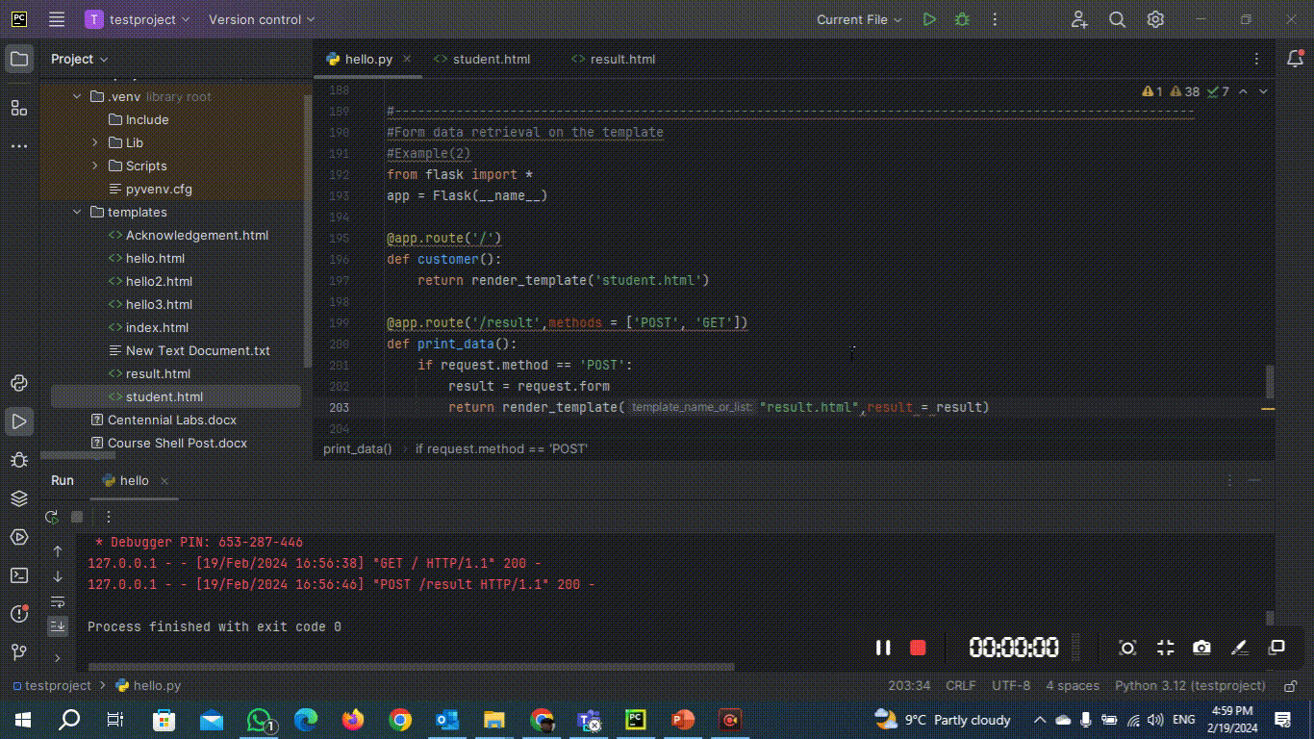
Output

Slide 52
Flask File Uploading
File uploading is the process of transmitting the binary or normal files to the server. Flask facilitates us to upload the files easily. All we need to have an HTML form with the encryption set to multipart/form-data. The server-side flask script fetches the file from the request object using request.files[] Object. On successfully uploading the file, it is saved to the desired location on the server.

Slide 53
Flask File Uploading
The uploaded file is saved to the temporary directory of the server for a while before it is saved to some desired location.
The name of the destination file can be obtained using the following syntax.
name = request.files['file'].filename

Slide 54
We can mention the path of the folder where the file is to be uploaded to the server
And the maximum size of the uploaded file. This all can be done in the configuration settings of the flask object.
N | Syntax | Description
1 | app.config['UPLOAD_FOLDER'] | It is used to mention the upload folder.
2 | app.config['MAX_CONTENT-PATH'] | It is used to mention the maximum size of the file to be uploaded.

Slide 55
Example
In this example, a file selector(file_upload_form.html) is provided to the user where the user can select a file from the file system and submit it to the server.
At the server side, the file is fetched using the request.files['file'] object and saved to the location on the server.
Since we are using the development server on the same device, hence the file will be uploaded to the directory from where the flask script upload.py is executed.

Slide 56
upload.py
from flask import *
app = Flask(__name__)
@app.route('/')
def upload():
return render_template("file_upload_form.html")
@app.route('/success', methods = ['POST'])
def success():
if request.method == 'POST':
f = request.files['file']
f.save(f.filename)
return render_template("success.html", name = f.filename)
if __name__ == '__main__':
app.run(debug = True)

Slide 57
file_upload_form.html
<html>
<head>
<title>upload</title>
</head>
<body>
<form action = "/success" method = "post" enctype="multipart/form-data">
<input type="file" name="file" />
<input type = "submit" value="Upload">
</form>
</body>
</html>

Slide 58
Success.html
<html>
<head>
<title>success</title>
</head>
<body>
<p>File uploaded successfully</p>
<p>File Name: {{name}}</p>
</body>
</html>

Slide 59
Index.html
<html> <body> <form action = "http://localhost:5000/uploader" method = "POST" enctype = "multipart/form-data"> <input type = "file" name = "file" /> <input type = "submit"/> </form> </body> </html>
Example (2)
Acknowledgement.html
<html> <head> <title>success</title> </head> <body> <p>File uploaded successfully</p> <p>File Name: {{name}}</p> </body> </html>
#from distutils.log import debug from fileinput import filename from flask import * app = Flask(__name__) @app.route('/') def main(): return render_template("index.html") @app.route(‘/uploader', methods = ['POST']) def success(): if request.method == 'POST': f = request.files['file'] f.save(f.filename) return render_template("Acknowledgement.html", name = f.filename) if __name__ == '__main__': app.run(debug=True)
Notes:
https://pythonbasics.org/flask-upload-file/
https://www.geeksforgeeks.org/how-to-upload-file-in-python-flask/

Slide 60
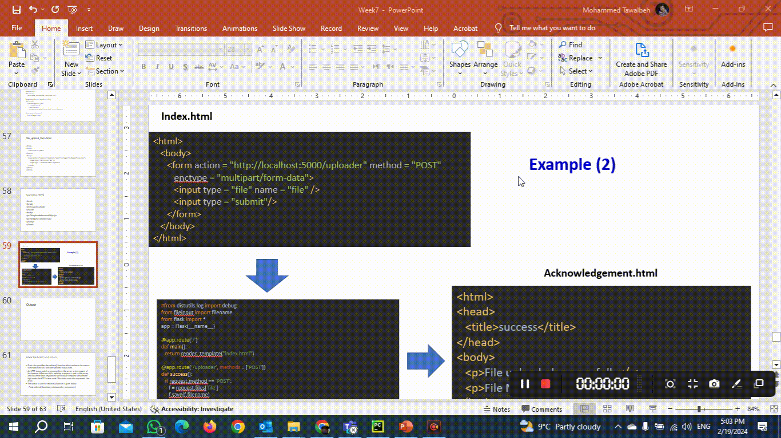
Output

Slide 61
Flask Redirect and Errors
Flask class provides the redirect() function which redirects the user to some specified URL with the specified status code.
An HTTP status code is a response from the server to the request of the browser. When we visit a website, a request is sent to the server, and the server then responds to the browser's request with a three-digit code: the HTTP status code. This status code also represents the error.
The syntax to use the redirect() function is given below.
Flask.redirect(<location>,<status-code>, <response> )

Slide 62
Example:
User is redirected to the success page with the HTTP status code 302 (found) on the successful login otherwise; the user reverts to this page only.
The following status codes are standardized −
HTTP_300_MULTIPLE_CHOICES
HTTP_301_MOVED_PERMANENTLY
HTTP_302_FOUND
HTTP_303_SEE_OTHER
HTTP_304_NOT_MODIFIED
HTTP_305_USE_PROXY
HTTP_306_RESERVED
HTTP_307_TEMPORARY_REDIRECT
The default status code is 302, which is for ‘found’.
400 - for error requests
401 - Used for unauthenticated
403 - Forbidden
404 - Not
406 - Not accepted
415 - for unsupported media types
429 - Too many requests

Slide 63
Example
Hello.py
# importing redirect from flask import Flask, redirect, url_for, render_template, request, abort # Initialize the flask application app = Flask(__name__) # It will load the form template which # is in login.html @app.route('/') def index(): return render_template("log_in.html") @app.route('/success') def success(): return "logged in successfully" # loggnig to the form with method POST or GET @app.route("/login", methods=["POST", "GET"]) def login(): # if the method is POST and Username is admin then # it will redirects to success url. if request.method == "POST" and request.form["username"] == "admin": return redirect(url_for("success")) else: abort(403) # # if the method is GET or username is not admin, # then it redirects to index method. return redirect(url_for('index')) if __name__ == '__main__': app.run(debug=True)
Log_in.html
<!DOCTYPE html> <html lang="en"> <body> <form method="POST", action="\login"> Username: <input name=username type=text></input><br> <button type="submit">Login</button> </form> </body> </html>

Slide 64
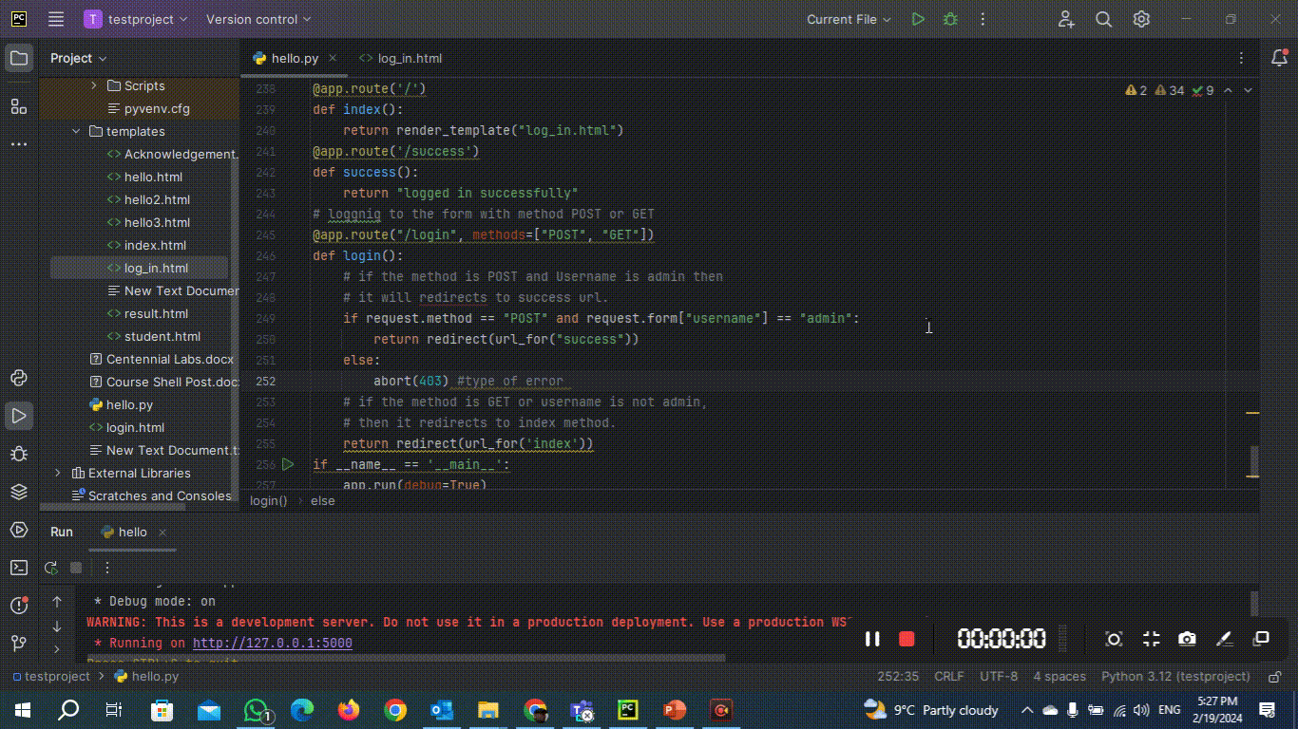
output

